Slide 1
HOSPITAL NETWORK
BY-Simranjeet singh
17BCS1708

Slide 2
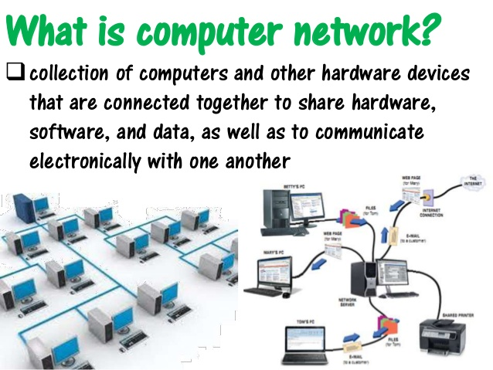
WHAT IS NETWORK

Slide 3
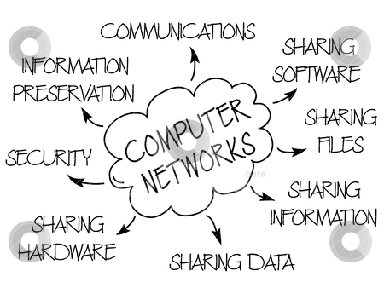
ADVANTAGES OF NETWORK

Slide 4
NETWORK DEVICES
NIC (Network Interface Card)
Repeater
Modem
Bridge
Hub
Switch
Router

Slide 5
ROUTER
Routers– A router is a device like a switch that routes data packets based on their IP addresses. Router is mainly a Network Layer device. Routers normally connect LANs and WANs together and have a dynamically updating routing table based on which they make decisions on routing the data packets. Router divide broadcast domains of hosts connected through it.

Slide 6
MODEM
Modem is a hardware device that converts data into a format suitable for a transmission medium so that it can be transmitted from computer to computer,modem modulates one or more carrier wave signals to encode digital information for transmission and demodulates signals to decode the transmitted information. The goal is to produce a signal that can be transmitted easily and decoded reliably to reproduce the original digital data.

Slide 7
SWITCH
Switch – A switch is a multiport bridge with a buffer and a design that can boost its efficiency(a large number of ports imply less traffic) and performance. A switch is a data link layer device. The switch can perform error checking before forwarding data, that makes it very efficient as it does not forward packets that have errors and forward good packets selectively to correct port only. In other words, switch divides collision domain of hosts, but broadcast domain remains same.

Slide 8
REPEATER
Repeater – A repeater operates at the physical layer. Its job is to regenerate the signal over the same network before the signal becomes too weak or corrupted so as to extend the length to which the signal can be transmitted over the same network. An important point to be noted about repeaters is that they do not amplify the signal. When the signal becomes weak, they copy the signal bit by bit and regenerate it at the original strength. It is a 2 port device.

Slide 9
BRIDGE
Bridge – A bridge operates at data link layer. A bridge is a repeater, with add on the functionality of filtering content by reading the MAC addresses of source and destination. It is also used for interconnecting two LANs working on the same protocol. It has a single input and single output port, thus making it a 2 port device.

Slide 10
HUB
Hub – A hub is basically a multiport repeater. A hub connects multiple wires coming from different branches, for example, the connector in star topology which connects different stations. Hubs cannot filter data, so data packets are sent to all connected devices. In other words, collision domain of all hosts connected through Hub remains one. Also, they do not have intelligence to find out best path for data packets which leads to inefficiencies and wastage.

Slide 11
Network Topology
Network Topology is the schematic description of a network arrangement, connecting various nodes(sender and receiver) through lines of connection.

Slide 12
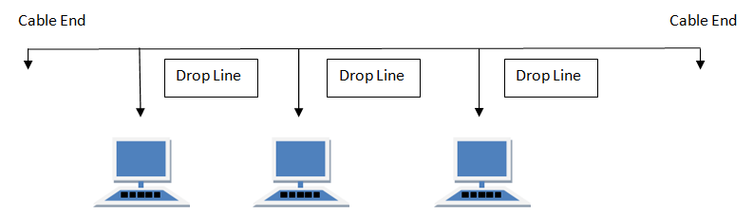
BUS Topology
Bus topology is a network type in which every computer and network device is connected to single cable. When it has exactly two endpoints, then it is called Linear Bus topology.

Slide 13
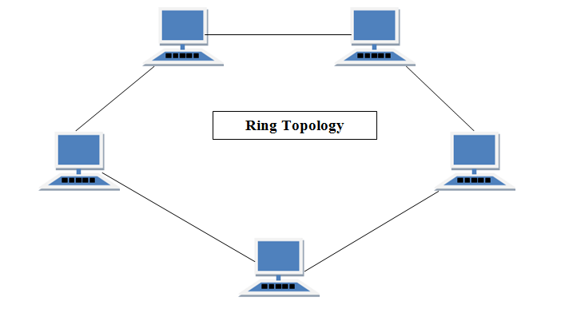
RING Topology
It is called ring topology because it forms a ring as each computer is connected to another computer, with the last one connected to the first. Exactly two neighbours for each device.

Slide 14
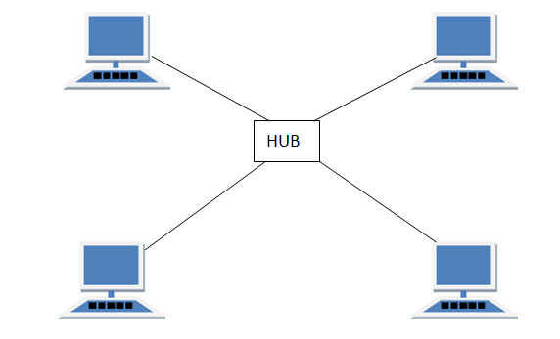
STAR Topology
In this type of topology all the computers are connected to a single hub through a cable. This hub is the central node and all others nodes are connected to the central node.

Slide 15
Routing
Routing is a process which is performed by layer 3 (or network layer) devices in order to deliver the packet by choosing an optimal path from one network to another.
Static routing –Static routing is a process in which we have to manually add routes in routing table.
Dynamic Routing –Dynamic routing makes automatic adjustment of the routes according to the current state of the route in the routing table. Dynamic routing uses protocols to discover network destinations and the routes to reach it

Slide 16
3.Default Routing –This is the method where the router is configured to send all packets towards a single router (next hop). It doesn’t matter to which network the packet belongs, it is forwarded out to router which is configured for default routing. It is generally used with stub routers. A stub router is a router which has only one route to reach all other networks.

Slide 17
Design of Hospital network
The main objective is to interconnect every single block and every single room of each block so that every computer in the hospital can communicate with any other computer in the hospital. There are few blocks in hospital premises located at a few distances from each other and every block has 20-25 computers and a few servers. This objective can be fulfilled by connecting every computer using any routing protocol. Static routing is used in this network. Static routing is easy to implement in small scale networks. They are very secure and predictable as the route to the destination is always remains the same. It doesn't require any routing algorithm or update mechanisms. Hence no extra resources such as CPU and memory is required.

Slide 18
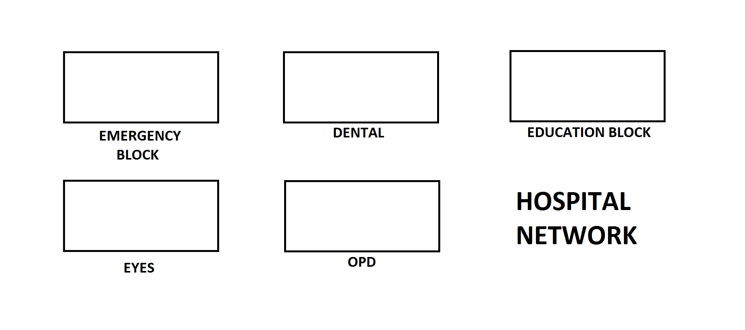

Slide 19
Number of Devices used
Emergency block has 1 router, 2 switches, and 48 computers.
Dental block has 1 router, 1 switches, and 18 computers.
OPD block has 1 router, 1 switch and 24 computer
Eye block has 1 router, 1 switch, and 48 computers.
Education block has 1 router,3 servers, 3 switches, and 53 computers.

Slide 20
PROCEDURE
First of all the routers and switches are placed according to the proposed design and computers are connected to them systematically. There are various techniques for making a connection. topologies like bus topology, star topology, ring topology. Computers are connected to the switches in star topology

Slide 21
The second step is providing IP Addresses to computers and servers. An Internet Protocol address is a numerical label assigned to each device connected to a computer network that uses internet protocol for communication. An IP address serves two main functions that are host or network interface identification and location addressing. All the computers connected in the design are given separate IP addresses. Routers are also assigned with different IP addresses which act as a gateway IP address. Switches are connected with routers with point to point topology. All the routers are connected to each other in a bus topology.

Slide 22
Static routing is performed on all the routers to interconnect them. Static routing is easy to implement in small scale networks. They are very secure and predictable as the route to the destination is always remains the same. Static routing is simply the process of manually entering routes into the routing table of a device using its a configuration file that is loaded when the routing device starts up. In static routing, all the modification in the logical network layout need to be manually done by the system administrator

Slide 23
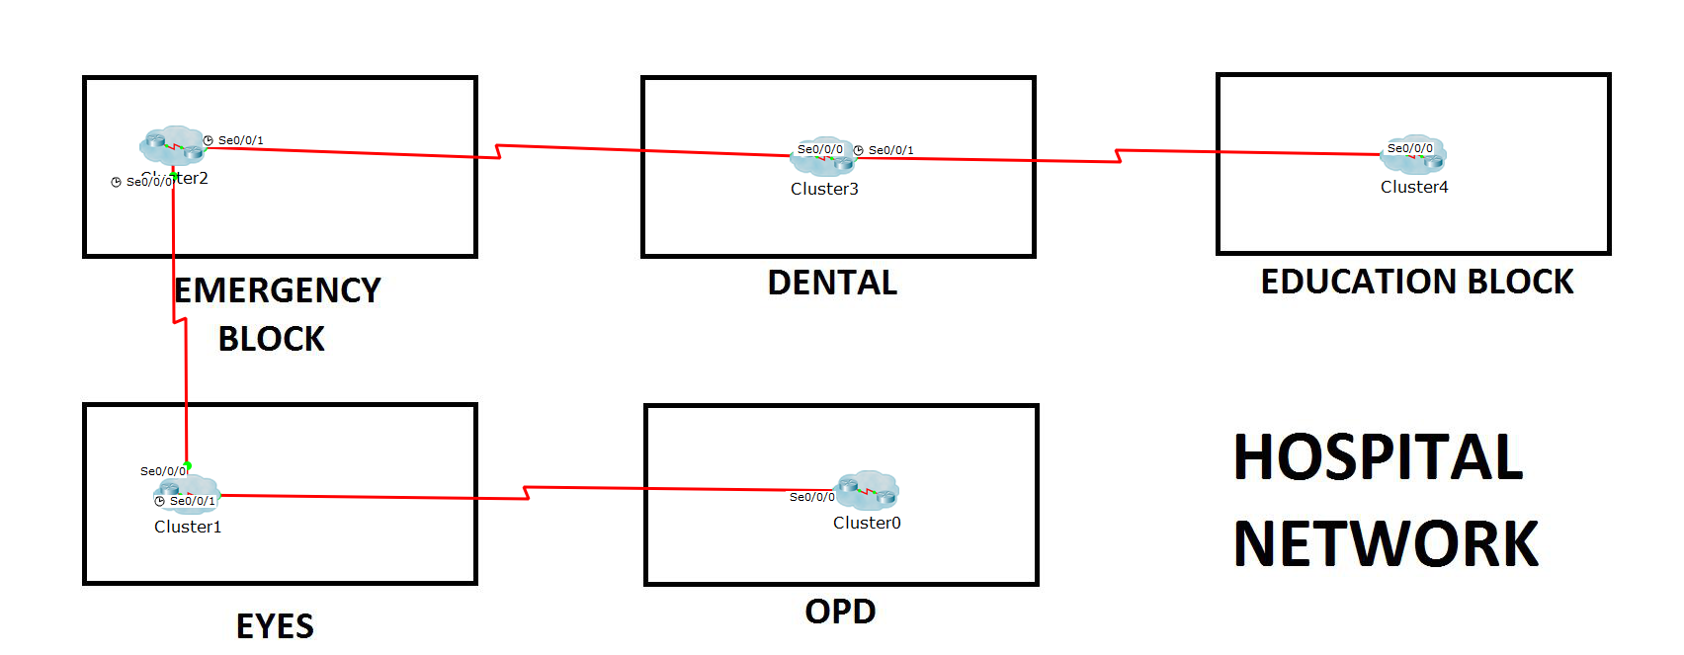
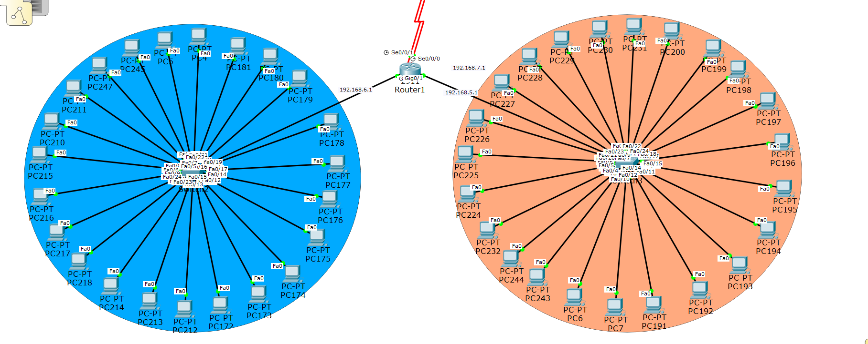
EMERGENCY BLOCK

Slide 24
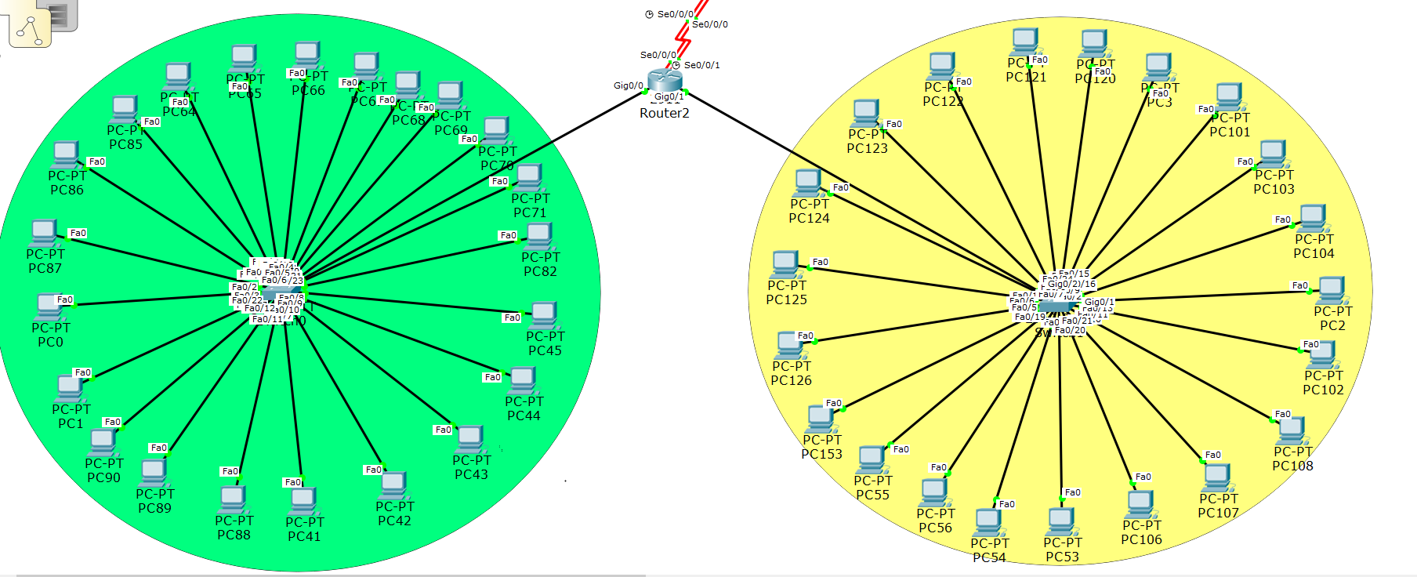
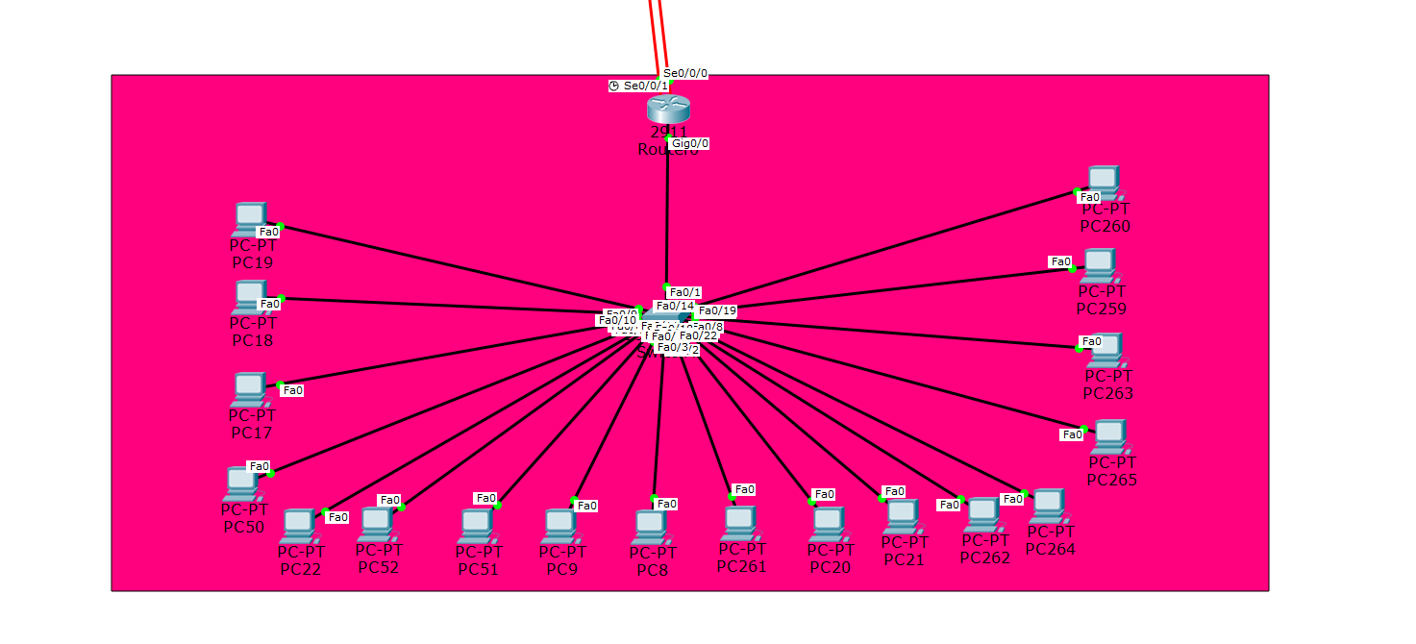
EYES BLOCK
DENTAL BLOCK

Slide 25
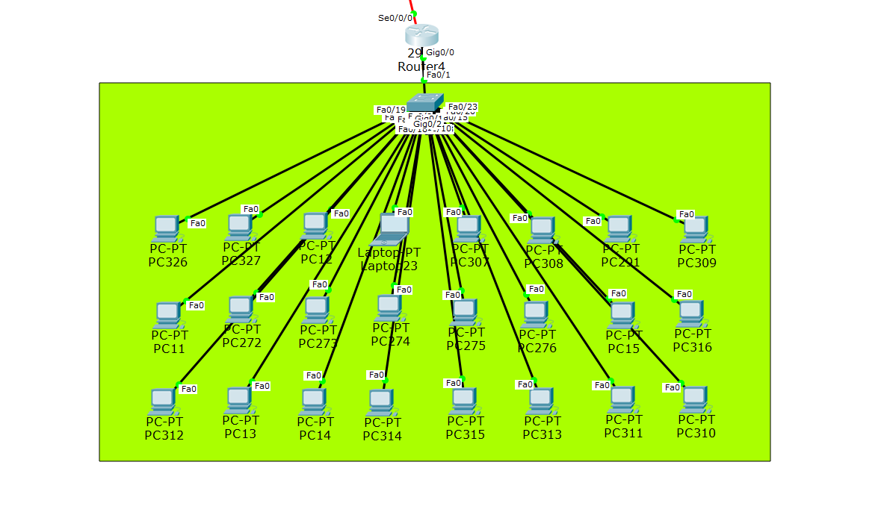
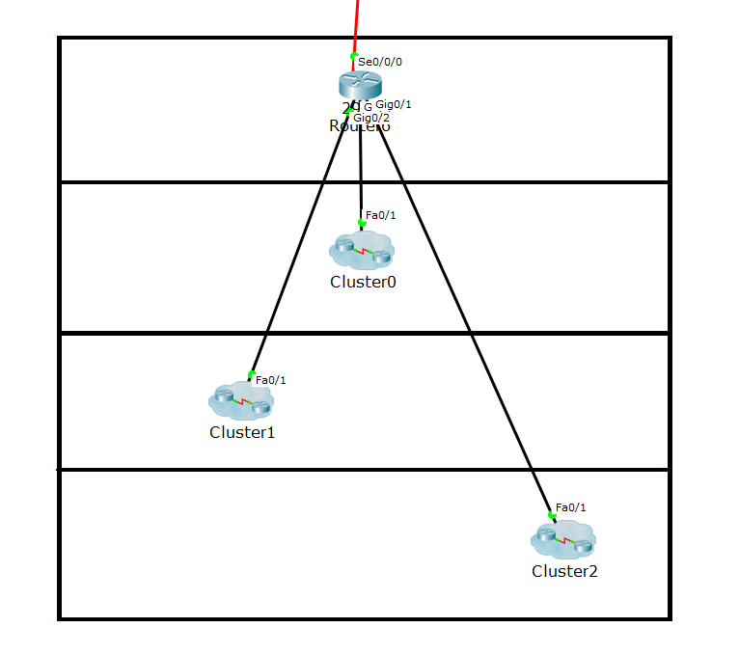
OPD
BLOCK
EDUCATION BLOCK

Slide 26
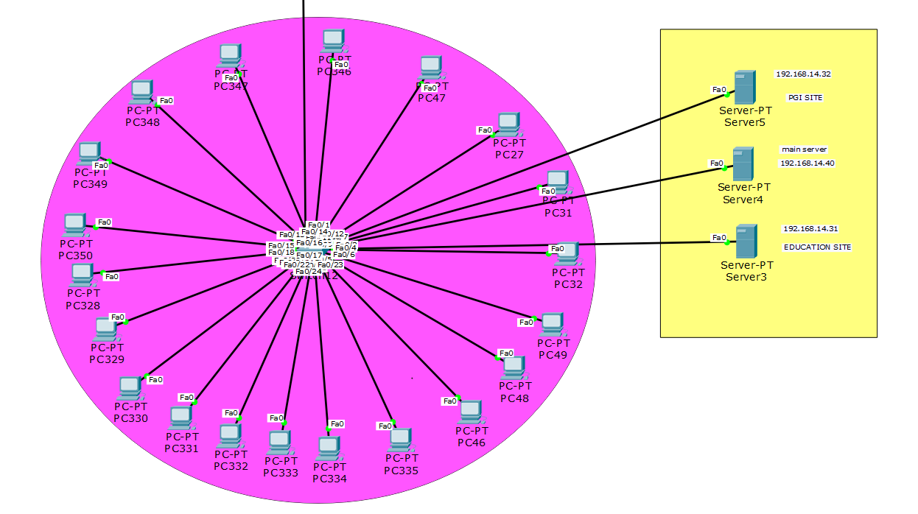
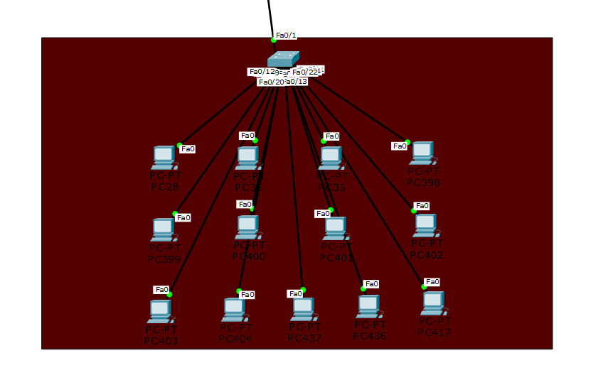
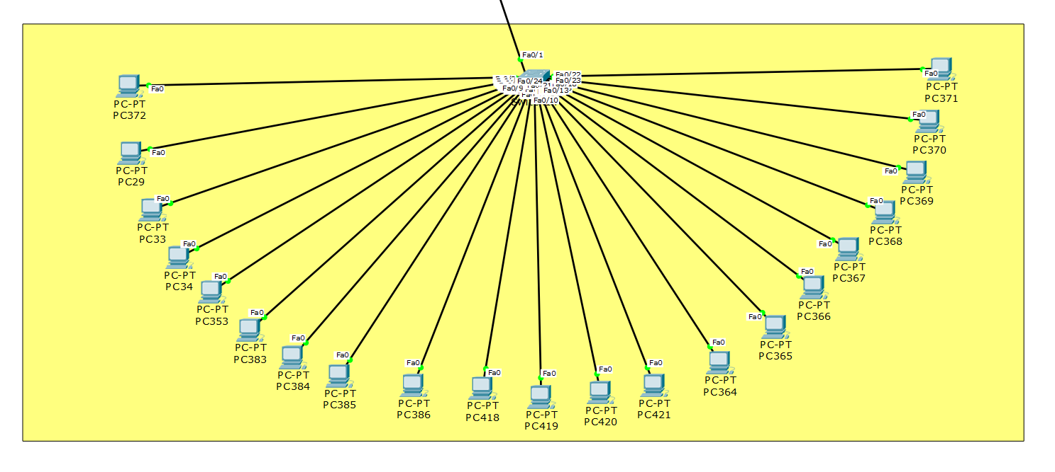
LEVEL 3
LEVEL 2
LEVEL 1

Slide 27

TESTING
We can test our created network by sending packet from one computer to another
TESTING- PC 17 TO PC 106

Slide 28
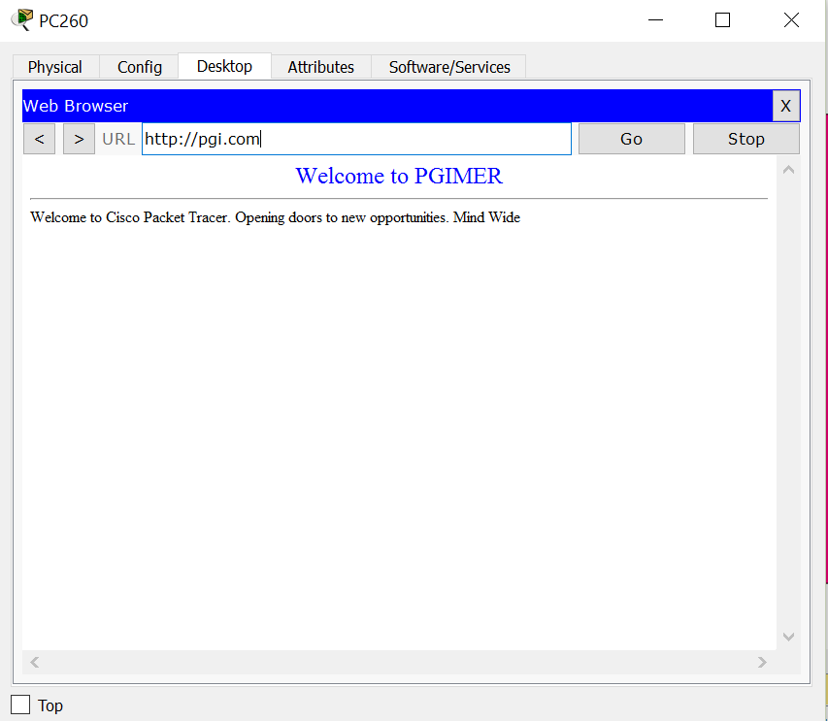
TEST – PGI SITE ON PC 260

Slide 29
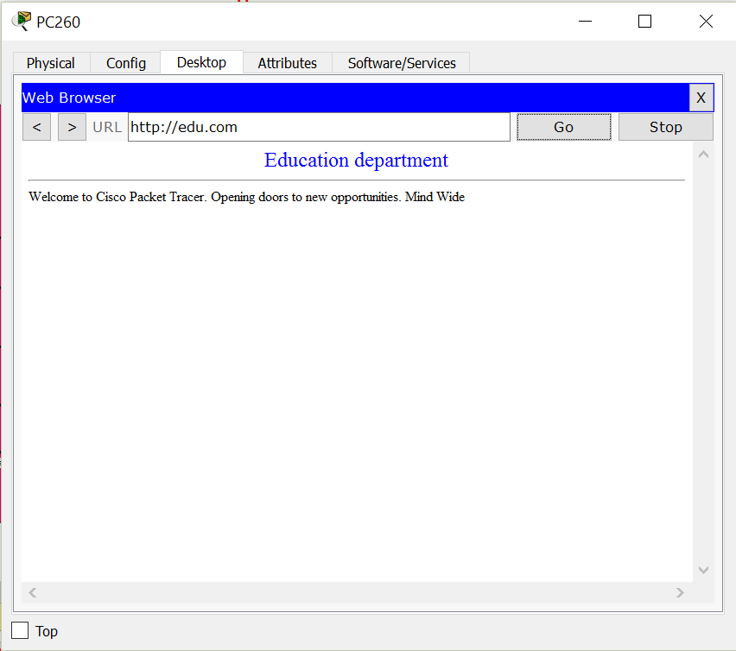
TEST – EDU SITE ON PC 260

Slide 30
CONCLUSION
There is a working model of a hospital network in which 170-200 computers are interconnected with each other. All the computer have static IP addresses which can communicate with each other within the network. There are 2 internet sites that are hosted on 2 different servers which can be accessed by any computer in the network. Both the site are hosted on a different server and they both have different IP addresses but they can be accessed by names i.e pgi.com and edu.com due to DNS service

Slide 31
THANK YOU
SUBMITED BY- Simranjeet singh
17BCS1708
SUBMITED T0- Er. Inderjeet Singh

